Slide 1

Retail Inventory Data Analysis Project SQL(2)
Project Performed on Mysql workbench platform

Slide 2

About :
This dataset provides synthetic yet realistic data for analyzing and forecasting retail store inventory demand. It contains over 73000 rows of daily data across multiple stores and products, including attributes like sales, inventory levels, pricing, weather, promotions, and holidays.
We have mostly focused about sales growth, demand forecasting, dynamic pricing, and inventory optimization and given data driven decision to grow sales and marketing.
We have performed this project on My SQL workbench for data retrieving ,data managing, and data analyzing.
Let’s go ahead this project and move on step-by-step problem statement.

Slide 3
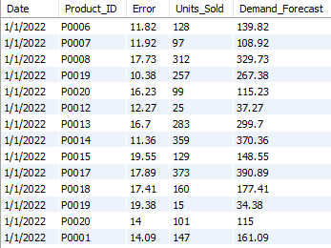
1. Calculate the daily forecast error for each product and return only days with major deviations.
WITH
Forecast_Error AS (
SELECT Date, Product_ID, Round(ABS(Demand_Forecast - Units_Sold),2) AS Error, Units_Sold, Demand_Forecast
FROM retail_inventory
)
SELECT *FROM Forecast_Error
WHERE Error > 10

Slide 4
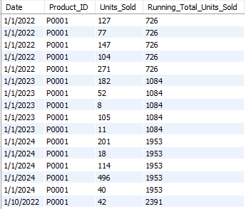
2. Track the running total of units sold for each product over time.
SELECT
Date,
Product_ID, Units_Sold, SUM(Units_Sold)
OVER (PARTITION BY Product_ID ORDER BY Date)
AS Running_Total_Units_Sold
FROM retail_inventory;

Slide 5
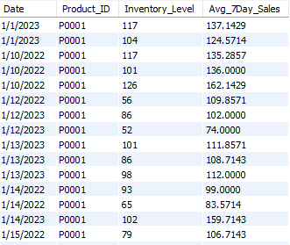
3.Identify products Who's average 7-day sales exceed inventory level, signaling restocking needs.
WITH Rolling_Avg_Sales AS (
SELECT Date, Product_ID, Inventory_Level, AVG(Units_Sold)
OVER (PARTITION BY Product_ID ORDER BY Date ROWS BETWEEN 6 PRECEDING AND CURRENT ROW) AS Avg_7Day_Sales
FROM retail_inventory
)
SELECT *FROM Rolling_Avg_Sales
WHERE Avg_7Day_Sales > Inventory_Level;

Slide 6

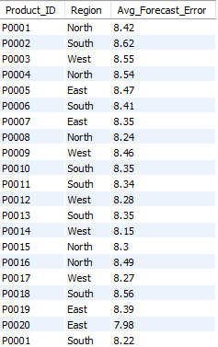
4. What is the average forecast error per product and region?
SELECT
Product_ID,
Region,
Round(AVG(ABS(Demand_Forecast - Units_Sold)),2)
AS Avg_Forecast_Error
FROM retail_inventory
GROUP BY Product_ID, Region;

Slide 7

5.Which weather conditions lead to the highest variance in demand?
SELECT
Weather_Condition,
Round(STDDEV(Units_Sold),2) AS Demand_Variability
FROM retail_inventory
GROUP BY Weather_Condition;

Slide 8
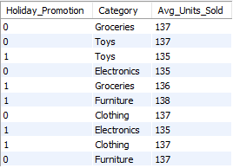
6.During which holidays or promotions did demand spike significantly?
SELECT
Holiday_Promotion,
Category,
Round(AVG(Units_Sold),0) AS Avg_Units_Sold
FROM retail_inventory
WHERE Holiday_Promotion IS NOT NULL
GROUP BY Holiday_Promotion, Category;

Slide 9
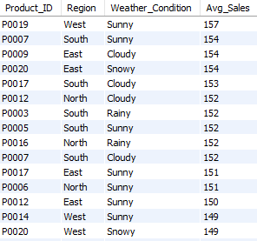
7.Can we find high-demand products under specific weather or regional conditions?
SELECT
Product_ID,
Region,
Weather_Condition,
Round(AVG(Units_Sold),0) AS Avg_Sales
FROM retail_inventory
GROUP BY Product_ID, Region, Weather_Condition
ORDER BY Avg_Sales DESC;

Slide 10
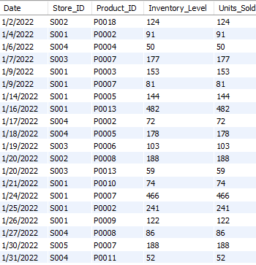
8.Which products frequently had stockouts (units sold equal to or greater than inventory)?
SELECT
Date,
Store_ID, Product_ID,
Inventory_Level, Units_Sold
FROM retail_inventory
WHERE Units_Sold >= Inventory_Level;

Slide 11
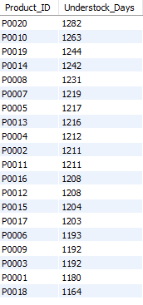
9. How often does actual demand exceed forecast, leading to understock?
SELECT
Product_ID,
COUNT(*) AS Understock_Days
FROM retail_inventory
WHERE Units_Sold > Demand_Forecast
GROUP BY Product_ID
ORDER BY Understock_Days DESC;

Slide 12
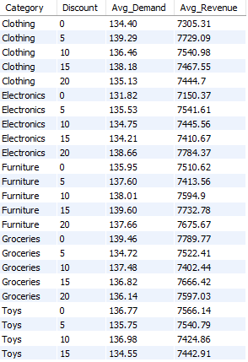
10. How do different discount levels influence product demand and revenue across categories?
SELECT
Category, Discount,
Round(AVG(Units_Sold),2) AS Avg_Demand,
Round(AVG(Price * Units_Sold),2) AS Avg_Revenue
FROM retail_inventory
GROUP BY Category, Discount
ORDER BY Category, Discount;

Slide 13
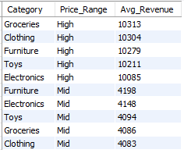
11.What price ranges generate the highest revenue per product category?
SELECT
Category,
CASE
WHEN Price < 10 THEN 'Low'
WHEN Price BETWEEN 10 AND 50 THEN 'Mid'
WHEN Price > 50 THEN 'High'
END AS Price_Range,
Round(AVG(Price * Units_Sold),0) AS Avg_Revenue
FROM retail_inventory
GROUP BY Category, Price_Range
ORDER BY Avg_Revenue DESC;

Slide 14
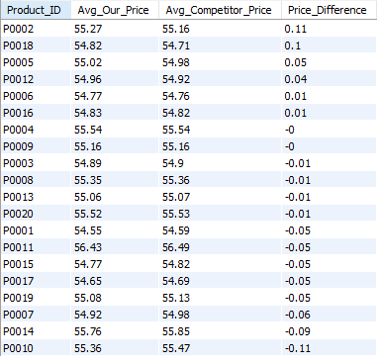
12. Are we pricing products competitively?
SELECT
Product_ID,
ROUND(AVG(Price), 2) AS Avg_Our_Price, ROUND(AVG(Competitor_Pricing), 2)
AS Avg_Competitor_Price,
ROUND(AVG(Price) - AVG(Competitor_Pricing), 2)
AS Price_Difference
FROM retail_inventory
GROUP BY Product_ID
ORDER BY Price_Difference DESC;

Slide 15

13. Are we losing sales when our prices exceed those of competitors?
SELECT
CASE
WHEN Price > Competitor_Pricing
THEN 'Above Competitor'
WHEN Price < Competitor_Pricing
THEN 'Below Competitor'
ELSE 'Equal to Competitor'
END AS Price_Comparison,
COUNT(*) AS Transactions,
SUM(Units_Sold) AS Total_Units_Sold,
ROUND(AVG(Units_Sold), 2) AS Avg_Units_Sold
FROM retail_inventory
GROUP BY Price_Comparison;

Slide 16
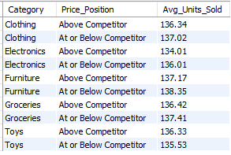
14. Which categories are most affected by higher pricing?
SELECT Category,
CASE
WHEN Price > Competitor_Pricing
THEN 'Above Competitor'
ELSE 'At or Below Competitor'
END AS Price_Position,
ROUND(AVG(Units_Sold), 2) AS Avg_Units_Sold
FROM retail_inventory
GROUP BY Category, Price_Position
ORDER BY Category, Price_Position;

Slide 17
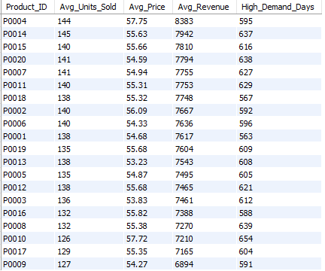
15. Are we underpricing high-demand products, resulting in lost revenue opportunities?
SELECT Product_ID,
Round(AVG(Units_Sold),0) AS Avg_Units_Sold,
Round(AVG(Price),2) AS Avg_Price,
Round(AVG(Price * Units_Sold),0) AS Avg_Revenue,
COUNT(*) AS High_Demand_Days
FROM retail_inventory
WHERE Units_Sold > Demand_Forecast
AND Price < Competitor_Pricing
GROUP BY Product_ID
ORDER BY Avg_Revenue DESC;

Slide 18
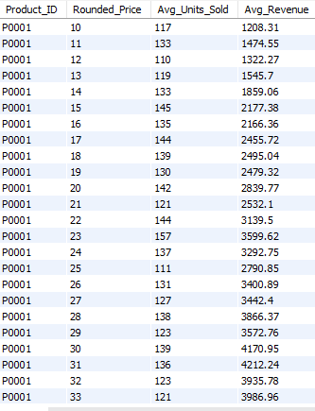
16. How does revenue fluctuate when prices are adjusted up or down relative to demand?
SELECT Product_ID,
ROUND(Price, 0) AS Rounded_Price,
Round(AVG(Units_Sold),0) AS Avg_Units_Sold,
Round(AVG(Price * Units_Sold),2) AS Avg_Revenue
FROM retail_inventory
GROUP BY Product_ID, Rounded_Price
ORDER BY Product_ID, Rounded_Price;

